Slide 1
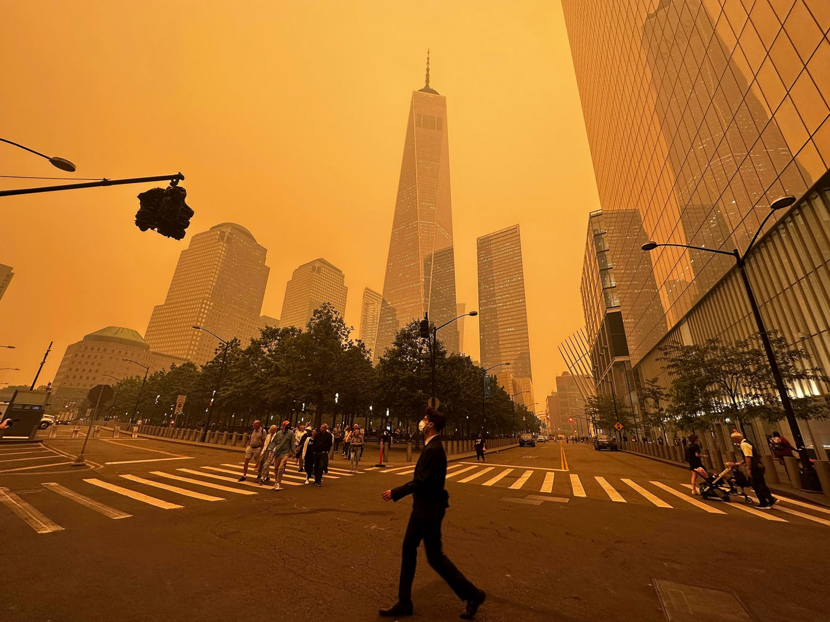
PROGRESS REPORT
Khongorzul 202355502

Slide 2

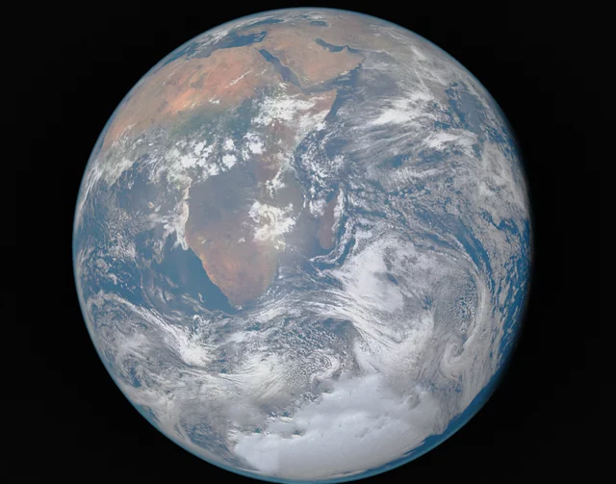
COMPLETED WORK SO FAR
User Interface Design: Layout with sections including header, navigation bar, main dashboard, and footer.
Data Display:
Real-time visualization of Temperature, Humidity, PM2.5, PM10, NOx, NH3, SO2, VOC, etc.
Display organized using cards or tables for easy interpretation.
Interactive Globe Visualization: Users can search for specific cities and view air quality data using Globe.js.
City Search: Implemented search functionality for city-specific air quality information.
AQI Details Display: Shows pollutants and weather conditions for selected cities.
Ranking Feature: Display of the most polluted cities based on real-time AQI data.

Slide 3
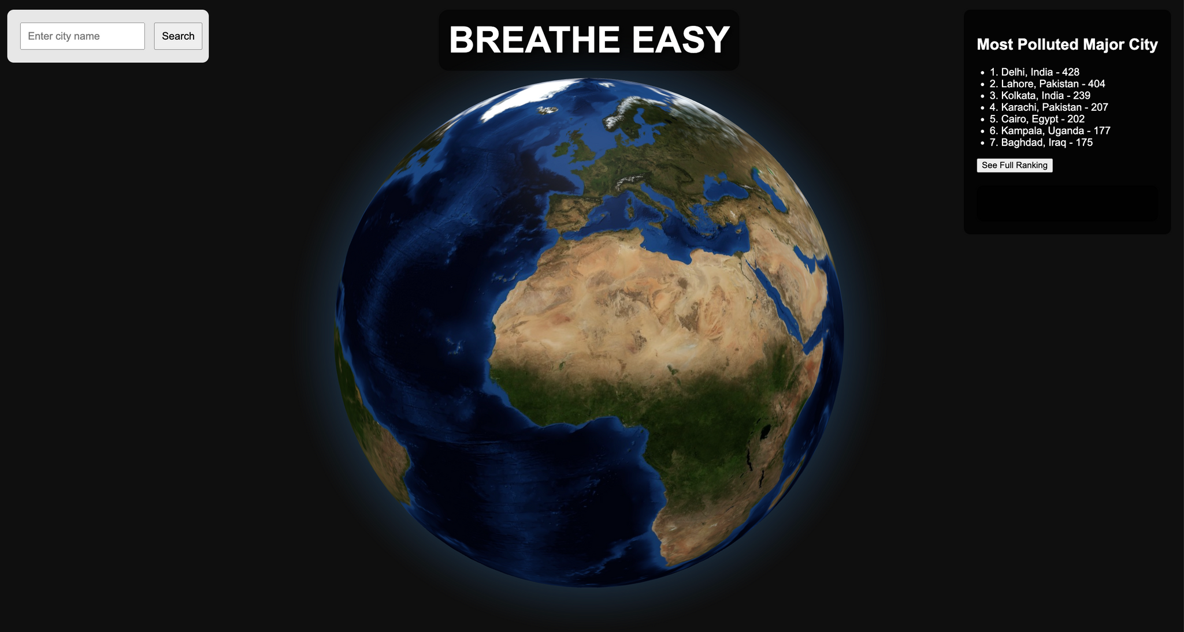

Slide 4
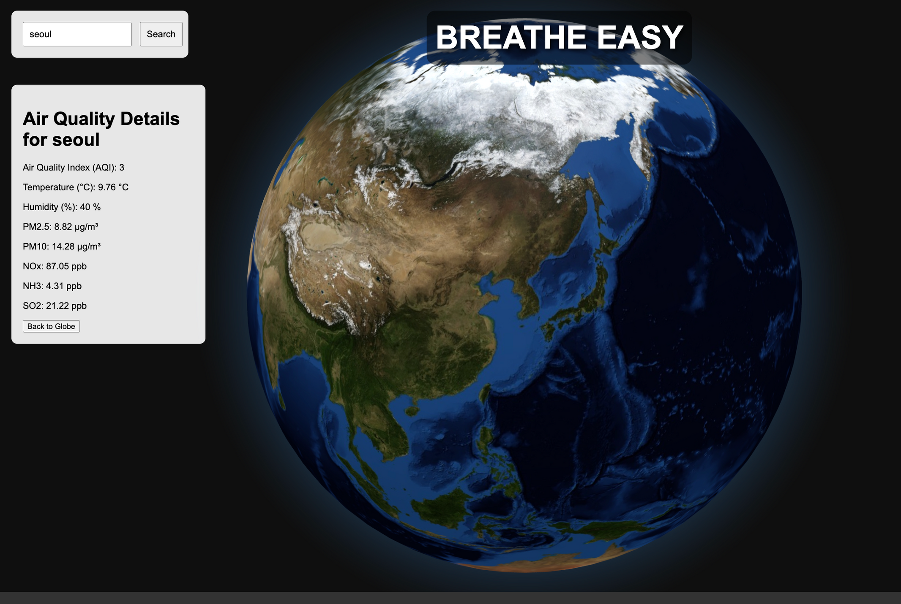
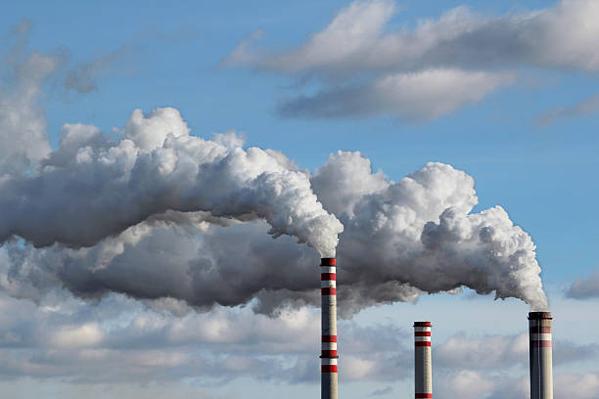
Features Implemented
Real-time Data Updates: Used stored CSV data for simulations; integrated real-time JSON data updates.
APIs Used: Integrated with OpenWeatherMap API to fetch real-time air quality, temperature, humidity, and other pollutant data.
Basic Globe Interaction: Users can rotate and zoom in/out on the globe using Globe.js for visualization.
Search Functionality: Users can search for cities to view air quality data, and the globe automatically rotates to the selected city.

Slide 5
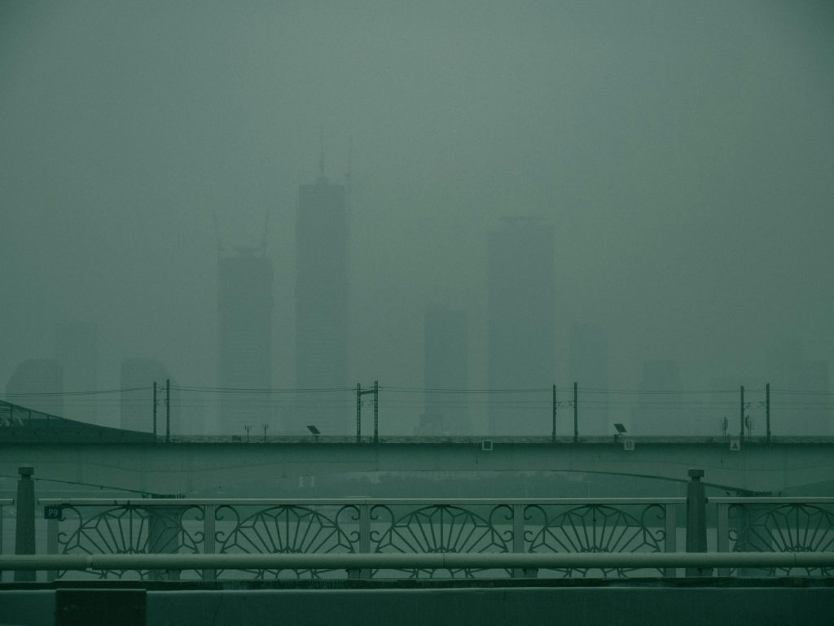
Upcoming Features & Improvements
Most Polluted Cities Historical Ranking: Plan to show AQI trends for major cities over time.
More Interactive Globe: Allow users to select specific regions or countries. Improved zoom features and more dynamic visual cues.
Major Air Pollutants: Adding additional data fields such as CO2, ozone (O3), and VOCs.
Advanced Visual Representation: Plan to implement Line Charts, Bar Charts, and Doughnut Charts for pollutant analysis, as well as heatmaps for areas with higher pollution levels.

Slide 6
Thank you very much!

